Slide 1
12 14 15 factor app
15/04/2022

Slide 2
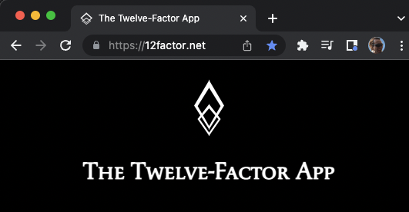
The twelve-factor app

Slide 3
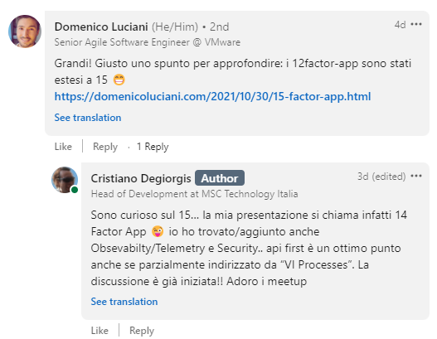
Meetup spirit
Special Thanks to Domenico Luciani!

Slide 4
The cloud-native manifesto
“A cloud-native application is an application that has been designed and implemented to run on a Platform-as-a-Service installation and to embrace horizontal elastic scaling.”
Beyond the Twelve-Factor App

Slide 5
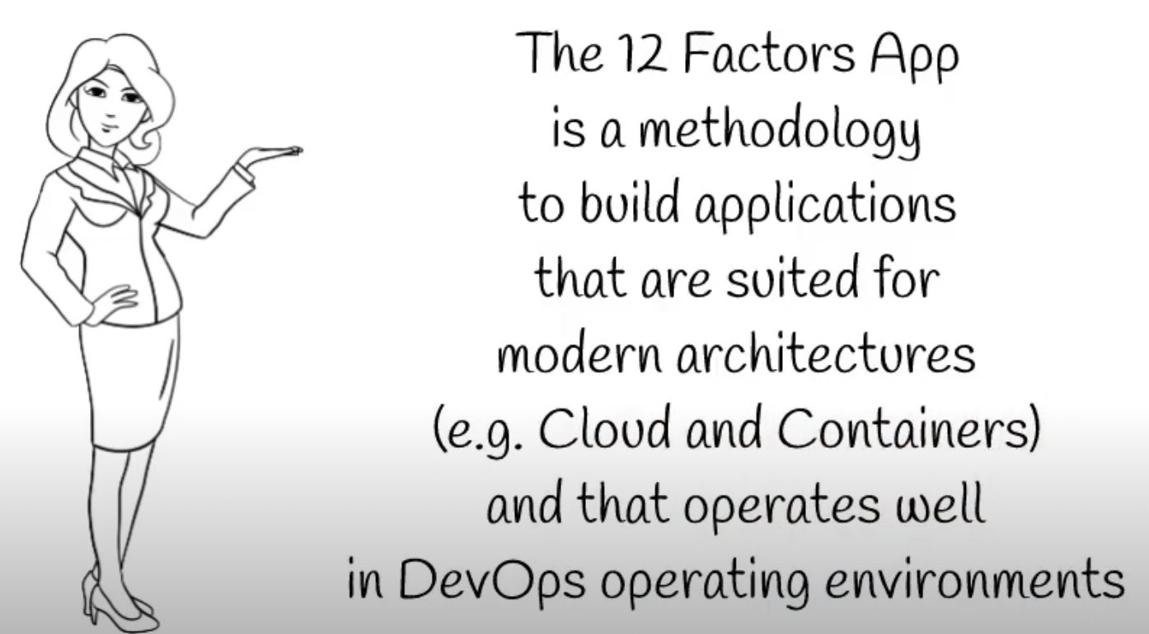
what

Slide 6
what
Rules
Guidelines
Principles

Slide 7
What is NOT
Design Patterns for building app
Framework or SDK

Slide 8
scope
Clear and Clean architecture
Automatable Deployment
Portability
Scalability
Maintainability

Slide 9
history
Built in 2012 by a group of people within Heroku
Published when there was no microservices or containers

Slide 10
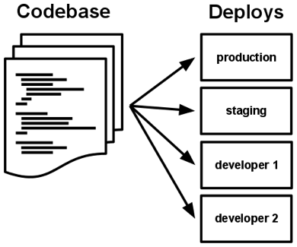
I. Codebase
One codebase tracked in revision control, many deploys
A codebase is any single repo or any set of repos who share a root commit

Slide 11
I. Codebase
Use version control
1 Deployment : 1 Repo
deploy as whole or not deploying at all
one repo many deployments in different envs
for multi-module projects use git submodule
discouraging monorepo containing different device/apps implementation (eg. mobile app)

Slide 12




II. Dependencies
Explicitly declare and isolate dependencies
A twelve-factor app never relies on implicit existence of system-wide packages

Slide 13
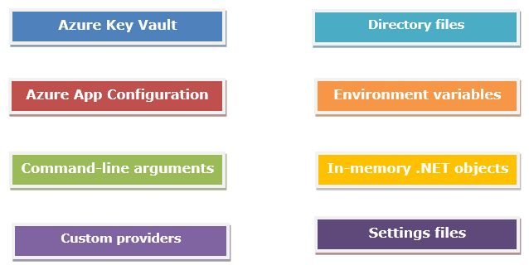
III. Config
Store config in the environment
strict separation of config from code

Slide 14
III. Config
Never, ever, store config in the source code
Configurations are kept separate from the code.
Store configuration in the environment
You don't have to redeploy or repackage your application when you have to change something in the configuration
Store configurations in git and push it via pipeline to the appropriate backing service
Configurations must be treated as environment-dependant
Config should be injected into the app at runtime

Slide 15
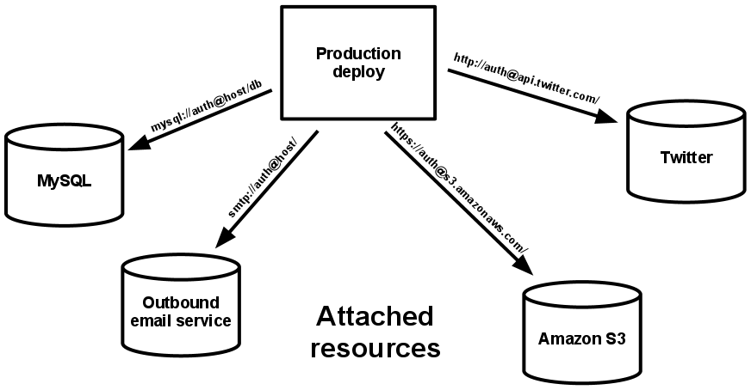
IV. Backing services
Treat backing services as attached resources
The code for a twelve-factor app makes no distinction between local and third party services

Slide 16
IV. Backing services
Data Sources are injected
App doesn't distinguish between local and remote services
Databases
Message-Oriented-Middleware
Caching servers
Configuration & Secrets managers
Local and remote services can be swapped via configuration w/o code changes

Slide 17
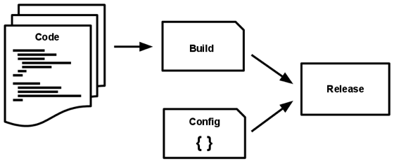
V. Build, release, run
Strictly separate build and run stages
The twelve-factor app uses strict separation between the build, release, and run stages

Slide 18
V. Build, release, run
Strictly separate build and run stages
Build phase: where source code is built into a binary executable
Release phase: where configuration is attached to the binary to make it a deployable unit
Run stage (aka runtime): where the deployable unit runs
Launch or restart your app from same immutable image guarantees each process will be exactly the same
That’s how you deploy your code from the repository to the cloud or any traditional server
Requires CI + CD pipelines to deploy from the repo to server/host. Once the CI pipeline is successful, the CD pipeline will automatically run and attach the configurations of your backing services and then start the application

Slide 19
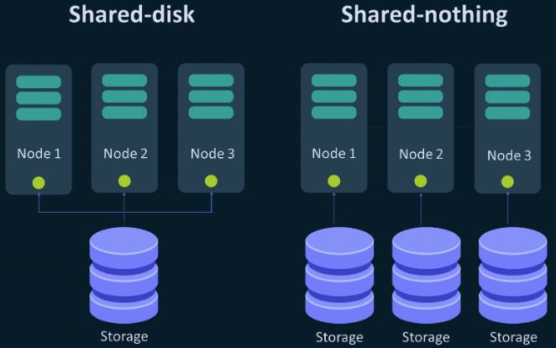
VI. Processes
Execute the app as one or more stateless processes
Twelve-factor processes are stateless and share-nothing

Slide 20
VI. Processes
Apps "share nothing"
Apps should not maintain any state in itself
Apps should not sharing anything between them: neither data or context.
Sharing should be happen through endpoints only
State of the application is stored only in a backing service

Slide 21
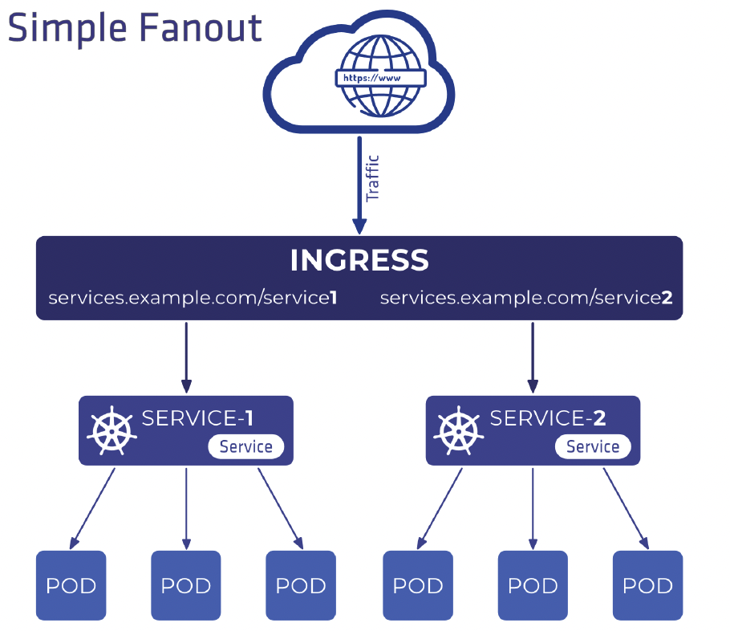
VII. Port binding
Export services via port binding
The twelve-factor app is completely self-contained

Slide 22
VII. Port binding
Apps are standalone/self-contained
Exposes services via port-binding
The host decides on which port the app will run, not vice versa
Each app has an embedded server: does not depend on external server/host
In a non-local env, a router is responsible to direct calls from an ingress point to the port exposed by the app
It means that one app can become the backing service for another app.

Slide 23
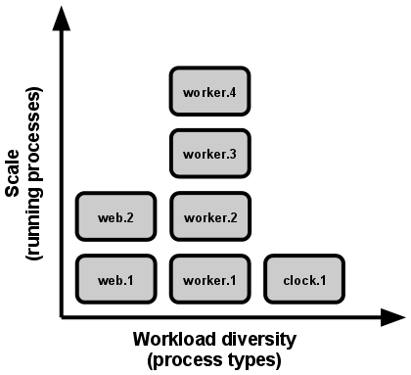
VIII. Concurrency
Scale out via the process model
In the twelve-factor app, processes are a first class citizen: the unix process model for running service daemons.

Slide 24
VIII. Concurrency
Easy to scale (up/vertical & out/horizontal)
You can create as many instance you want of your app
Scaling should be based on the load or the traffic that s coming to the environment
Apps should never daemonize instead, rely on the operating system’s process manager

Slide 25
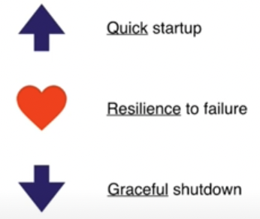
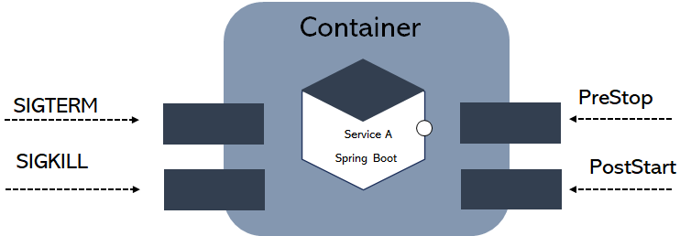
IX. Disposability
Maximize robustness with fast startup and graceful shutdown
The twelve-factor app’s processes are disposable, meaning they can be started or stopped at a moment’s notice

Slide 26
IX. Disposability
pets vs cattle
Quick start-up
~ milliseconds
Resilience to failure
a compensation should occur
Graceful shutdown
sigterm should clean all resources was using it (shut-down ~10 sec)

Slide 27
X. Dev/prod parity
Keep development, staging, and production as similar as possible
 | Traditional app | Twelve-factor app
Time between deploys | Weeks | Hours
Code authors vs code deployers | Different people | Same people
Dev vs production environments | Divergent | As similar as possible
The twelve-factor developer resists the urge to use different backing services between development and production,

Slide 28
X. Dev/prod parity
Environments similarity
Environments differences: same architecture vs different SKU
What and how you deploy in prod should be the same as dev, stage and any other environments
Parity => Reproducibility => Disposability
Keep environments segregated each others
The author (team) of the code and who deploy the application is the same person.

Slide 29
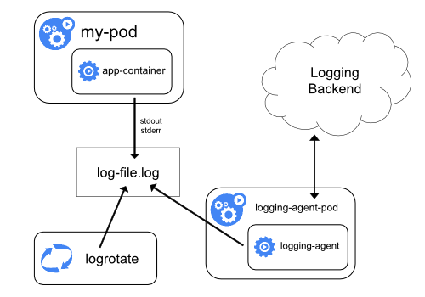
XI. Logs
Treat logs as event streams
https://kubernetes.io/docs/concepts/cluster-administration/logging/
A twelve-factor app never concerns itself with routing or storage of its output stream

Slide 30
XI. Logs
Apps must not rely on local durable file systems
same host
same machine
same logfile
Should be streamed to different processes
Splunk
DataDog
FluentD
Elastic Stack
Make it available to the standard output

Slide 31
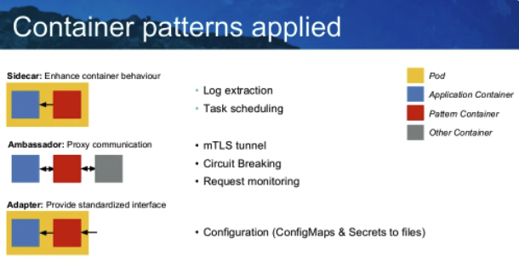
XII. Admin processes
Run admin/management tasks as one-off processes
Running database migrations, console, one-time scripts

Slide 32
XII. Admin processes
Admin processes should run isolated from main process
db migrations
background jobs
tracking the app within a registry
checking dependencies
spinning new server
Main & admin processes use same
codebase
config
release

Slide 33
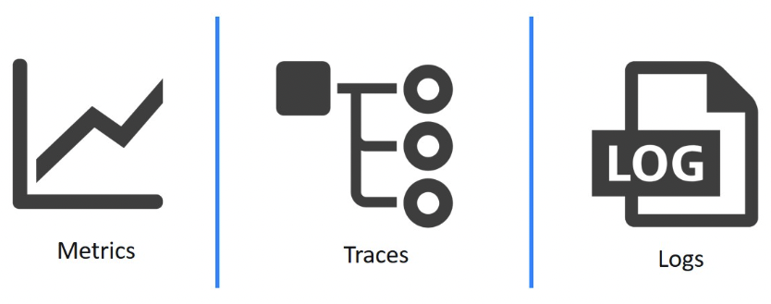
XII. Observability
Internal states of a system can be inferred from knowledge of its external outputs

Slide 34
XII. Observability
Performance Metrics
Domain Specific (domain objects) Telemetry
Tracing
Health checks
System Logs

Slide 35

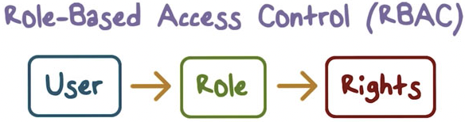

XIV. security
Modern apps should take security-first

Slide 36
XIV. security
HTTPS/TLS
OAuth, OpenIdConnect, SAML2
MFA
RBAC
Audit trail

Slide 37
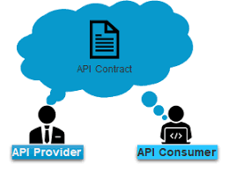
XV. API FIRST
APIs are treated as “first-class citizens”

Slide 38
XIV. API FIRST
Speed up integrations via Contracts & Mocks
Use documentation standards for easy consumption
REST for external vs gRPC for internal consumers
TLS & Certificates

Slide 39
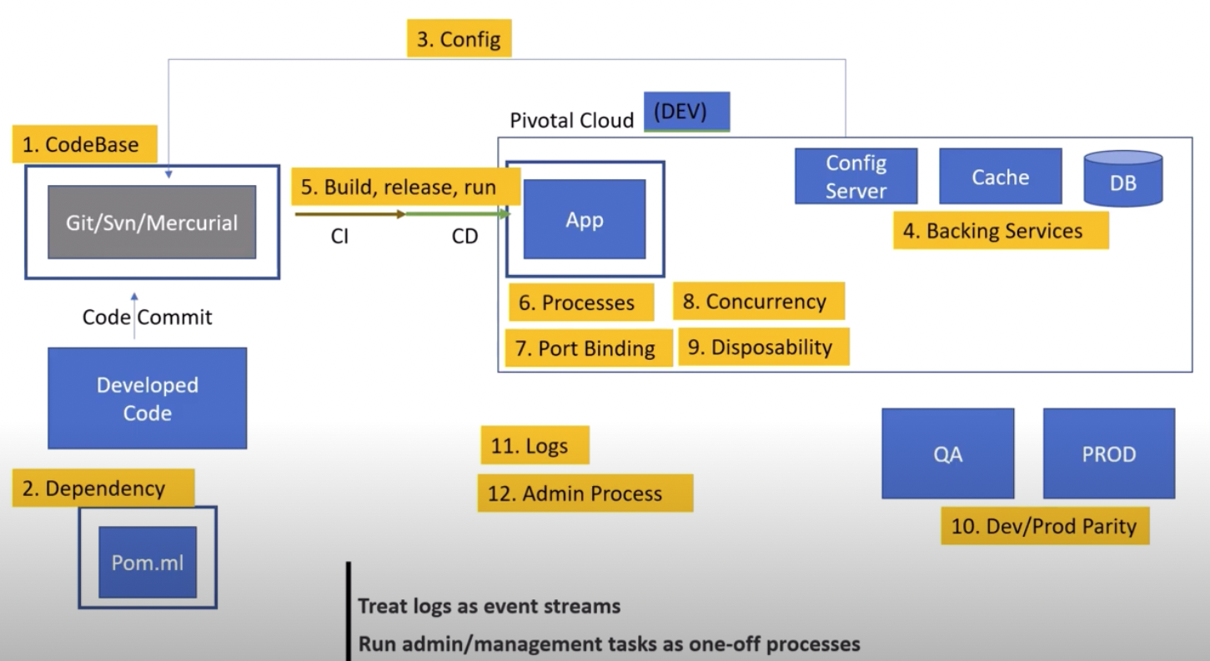
The global view

Slide 40
references
The twelve-factor app
12 Factor App - #6MinuteSaturdays #1 | Tech Primers
12 Factors App | MicroServices Architecture | Cloud Native Best Practices
Introduction to 12 Factor App
5 Years of 12 Factor Apps by Joe Kutner
The Fifteen-Factor App
Beyond the Twelve-Factor App

